Slide 1

Driven to Help
Restoring transportation independence
in Dayton, Ohio
EST. 2026
501(C)(3) NONPROFIT ORGANIZATION

Slide 2
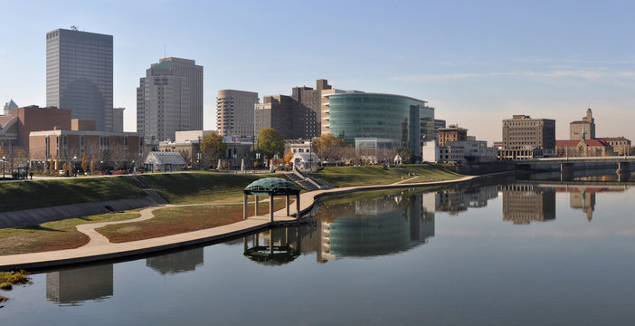
OUR MISSION
"
Driven to Help restores transportation independence for those in need in the Dayton, Ohio region through license reinstatement, driver's education,
vehicle acquisition, maintenance training, insurance support, and one year of guaranteed insurance and vehicle warranty coverage to sustain client independence.
"
— DRIVEN TO HELP MISSION STATEMENT

Slide 3
Transportation Is the Barrier
Across America, millions are locked out of opportunity by license suspensions and lack of vehicle access.
11 Million+
~75%
42%
45%
of formerly incarcerated individuals identify transportation as a top barrier to successful reentry and employment.
of people who lose their license also lose their job — and those who keep working see average income drop by 88%.
of American households have zero access to public transit. In car-dependent metros, no license means no mobility.
Americans have suspended driver's licenses for unpaid fines and fees — not for unsafe driving.
Sources: Free to Drive Coalition · Fines & Fees Justice Center · National Institute of Justice · AAMVA · Brookings Institution
Next: Zooming into Dayton

Slide 4
The Crisis Is Local
Transportation barriers hit Dayton and Ohio harder than most.
1.66M
25.5%
14%
22 Routes
Ohio drivers had active debt-related license suspensions in 2020 — over 60% of all suspensions stem from unpaid debt, not unsafe driving.
Dayton residents live below the poverty line — more than double the national rate of 12.2%. Median household income is just $45,846, barely half the U.S. median.
of Ohio job postings now require a valid driver's license — up from 8% in 2015. A suspended license doesn't just limit mobility, it locks people out of employment.
serve the entire Greater Dayton RTA system. Limited public transit means a car isn't a luxury — it's the only reliable path to work, school, and services.
Federal Reserve Bank of Cleveland / Cleveland State University, 2024
U.S. Census Bureau, ACS 2024
Federal Reserve Bank of Cleveland, 2024
Greater Dayton RTA, 2026
Dayton faces a perfect storm: high poverty, mass license suspensions, rising employer requirements, and minimal transit alternatives.

Slide 5
Our Community
Serving the Dayton, Ohio Region & Montgomery County
Low-Income Individuals
Returning Citizens
Those who cannot afford license reinstatement fees, insurance, or vehicle costs — trapped in a cycle where transportation poverty limits every opportunity.
Formerly incarcerated individuals rebuilding their lives who need reliable transportation for employment, housing access, and successful community reentry.
Veterans
Others in Need
Service members transitioning to civilian life who face unexpected transportation gaps — especially those dealing with service-connected challenges.
Anyone in the Dayton region who has lost transportation independence due to financial hardship, legal barriers, or life circumstances beyond their control.
Driven to Help — Restoring Independence, One Journey at a Time

Slide 6
A Complete Path to Independence
Most organizations help make the first turn. Driven to Help navigates the full journey.
1
2
3
4
5
6
License
Reinstatement
Driver's
Education
Vehicle
Acquisition
Maintenance
Training
Insurance
Support
Sustainment
1 year of guaranteed insurance & warranty
Restore driving privileges
Build skills and confidence
Place clients in reliable vehicles
Teach hands-on vehicle care
Navigate coverage options
THE DTH JOURNEY
•
From First Step to Full Independence

Slide 7
Building the Foundation
Programs that remove barriers and prepare clients for the road ahead.
1
2
3
License Reinstatement Support
Driver's Education
Vehicle Acquisition
Court fee assistance and compliance plan development
Classroom instruction covering rules, safety, and defensive driving
Finalize client’s vehicle requirements
Vehicle sourcing through community donations, auctions, and dealer partnerships
Step-by-step BMV navigation and documentation support
Behind-the-wheel training with licensed instructors
Personalized roadmaps to restore driving privileges
Full exam preparation and testing support
Vehicle safety inspections and walkaround with clients in advance of hands-on maintenance training
Courts, public defenders & legal aid
Licensed driving school partnerships
Sinclair Community College & local auto shops
DRIVEN TO HELP
DTH Programs 3 - 6

Slide 8
Sustaining Independence
Programs that keep clients on the road — long after day one.
4
5
6
Vehicle Maintenance Training
Insurance Support
KEY DIFFERENTIATOR
Hands-on workshops using client’s newly-acquired vehicle: oil changes, tire care, fluid checks & battery maintenance
Education on Ohio minimum insurance requirements and coverage options
Sustainment (1-Year)
12 months of DTH-paid vehicle insurance after placement
Policy comparison assistance and partnerships for reduced-cost coverage
Basic troubleshooting and preventive care skills
Modest vehicle warranty covering critical repairs
Empowering long-term vehicle reliability and cost savings
DTH guides clients through the process — we are not brokers
Transition planning to self-funded, long-term independence
Local insurance companies and brokers
DRIVEN TO HELP

Slide 9
Why Driven to Help Is Different
COMPLETE MODEL
Typical Vehicle Programs
The DTH Model
Fragmented approach
END-TO-END SOLUTION
Focus on a single service — vehicle donation or legal aid, never both
Complete 6-program journey from license reinstatement to vehicle ownership
No post-placement support once the client drives away
12-month post-placement insurance and vehicle warranty coverage
Clients left to figure out insurance on their own
Maintenance training completed before keys are handed over
High vehicle failure rate without maintenance knowledge
VS
Insurance navigation built directly into the process
No accountability or follow-up after placement
Transition planning for long-term self-sufficiency
Measurable outcomes tracked across every program
Others give a car. DTH builds a driver.
DRIVEN TO HELP

Slide 10
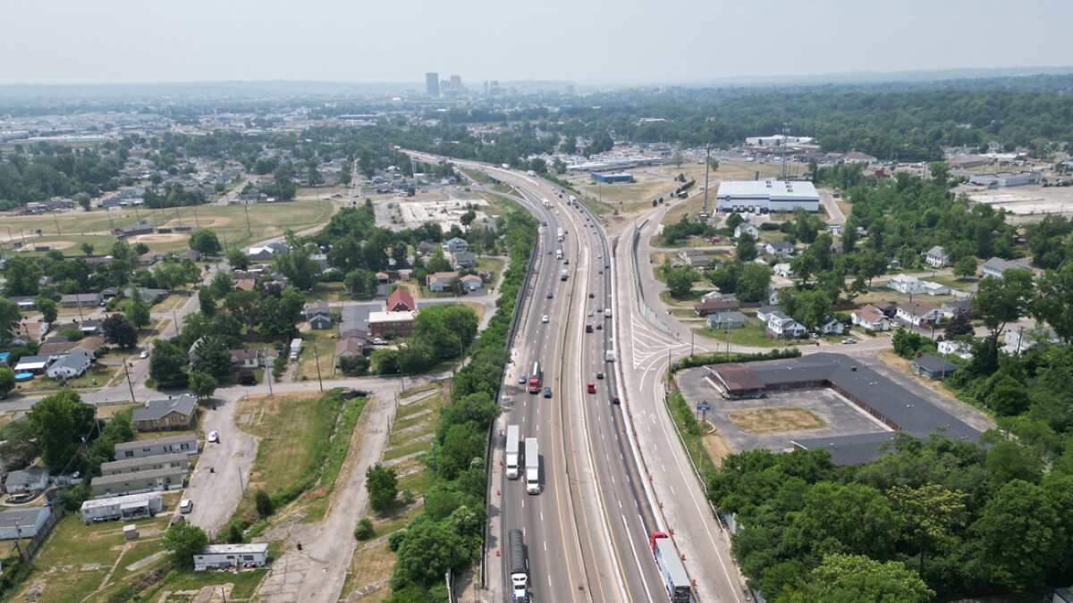
OUR VISION
"
A Dayton with an open road to a living wage
"
DRIVEN TO HELP

Slide 11
Drive the Mission Forward
Partner with us. Fund a program. Donate a vehicle. Change a life.
Donate
Volunteer
Fund license reinstatements, insurance coverage, and vehicle repairs for those who need it most.
Mentor clients, teach maintenance workshops, and provide your professional expertise.
Partner
Spread the Word
Auto shops, driving schools, insurance agents, and employers — join our network of impact.
Share our mission and help us reach those who need transportation independence most.
Driven to Help
|
Dayton, Ohio
|
driventohelp.org
|
info@driventohelp.org

